Slide 1
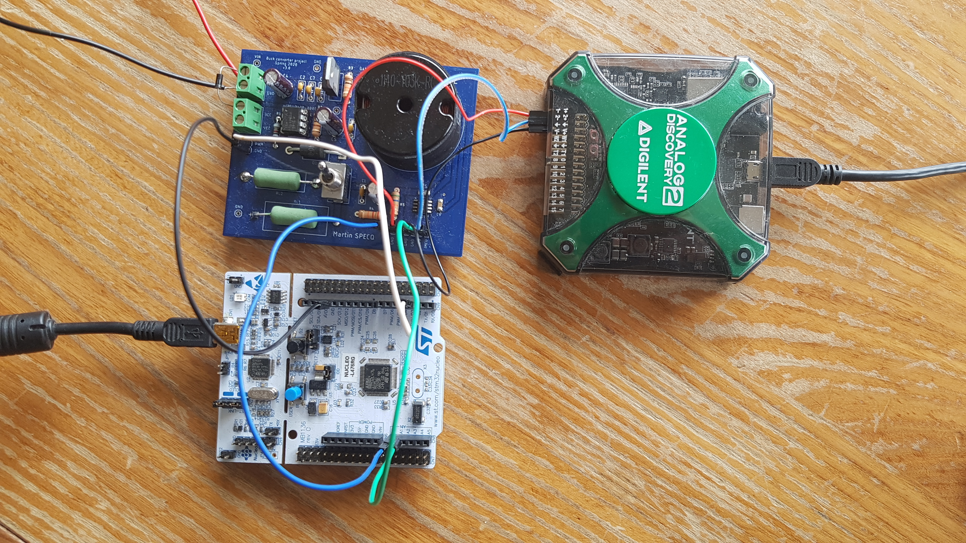
Embedded control of a step-down DC-DC converter
Author : Martin Specq
Supervisor : Emilio Maddalena
Professor : Colin Jones

Slide 2
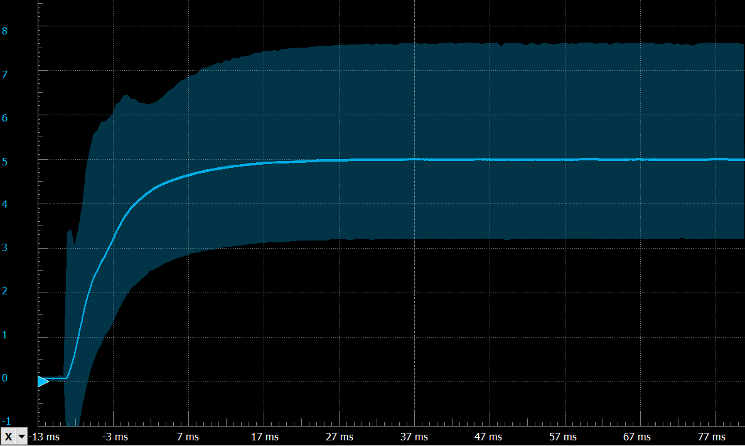
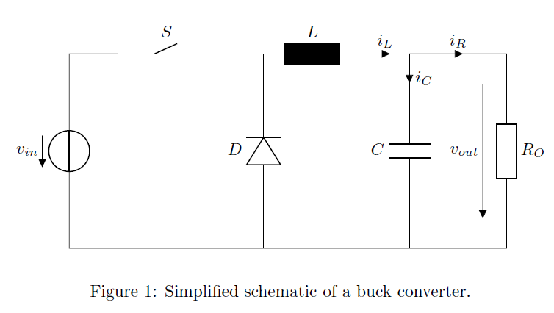
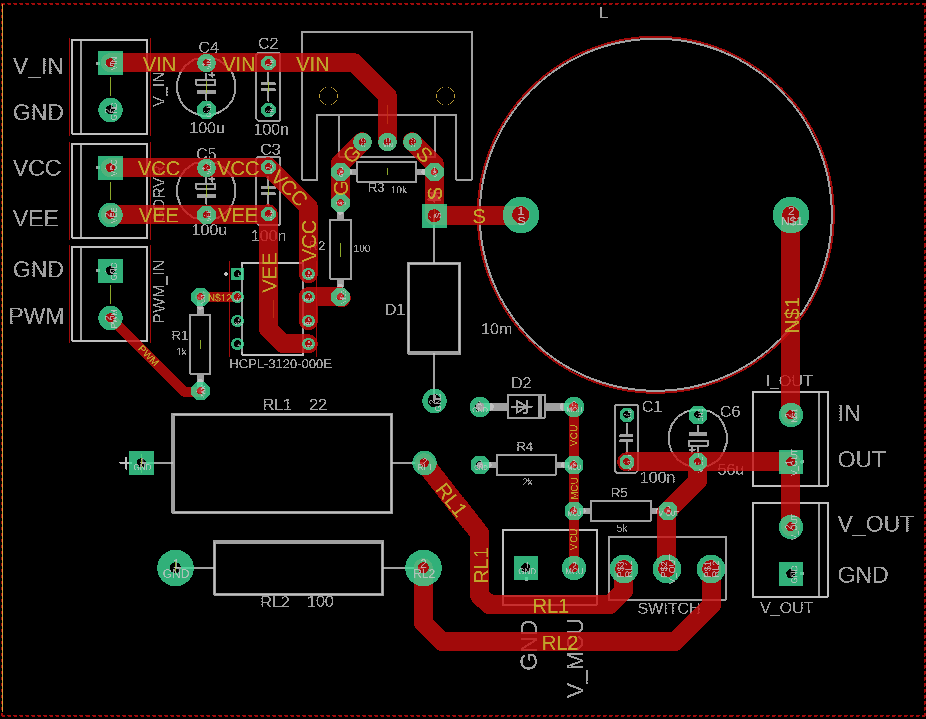
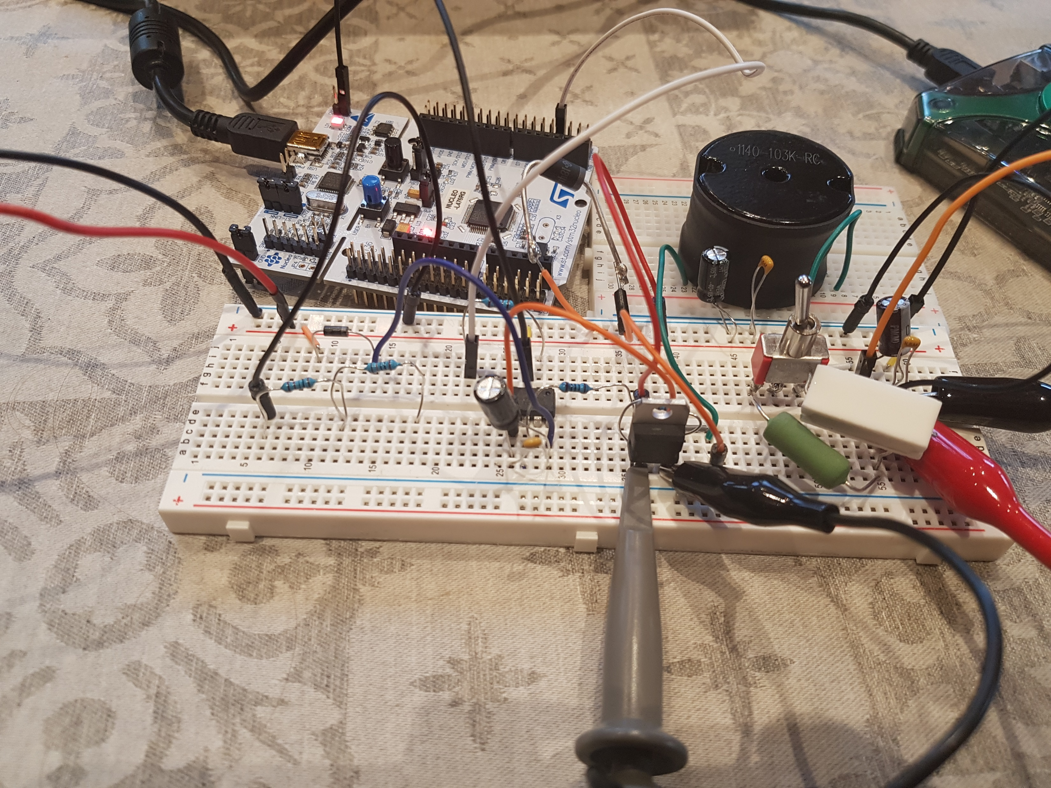
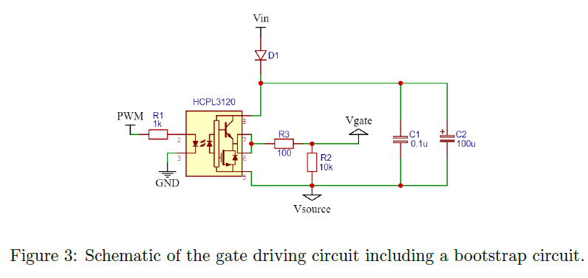
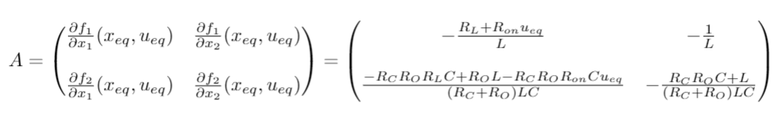
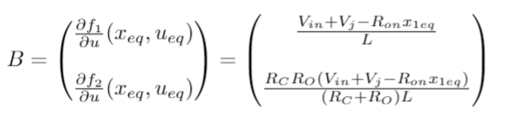
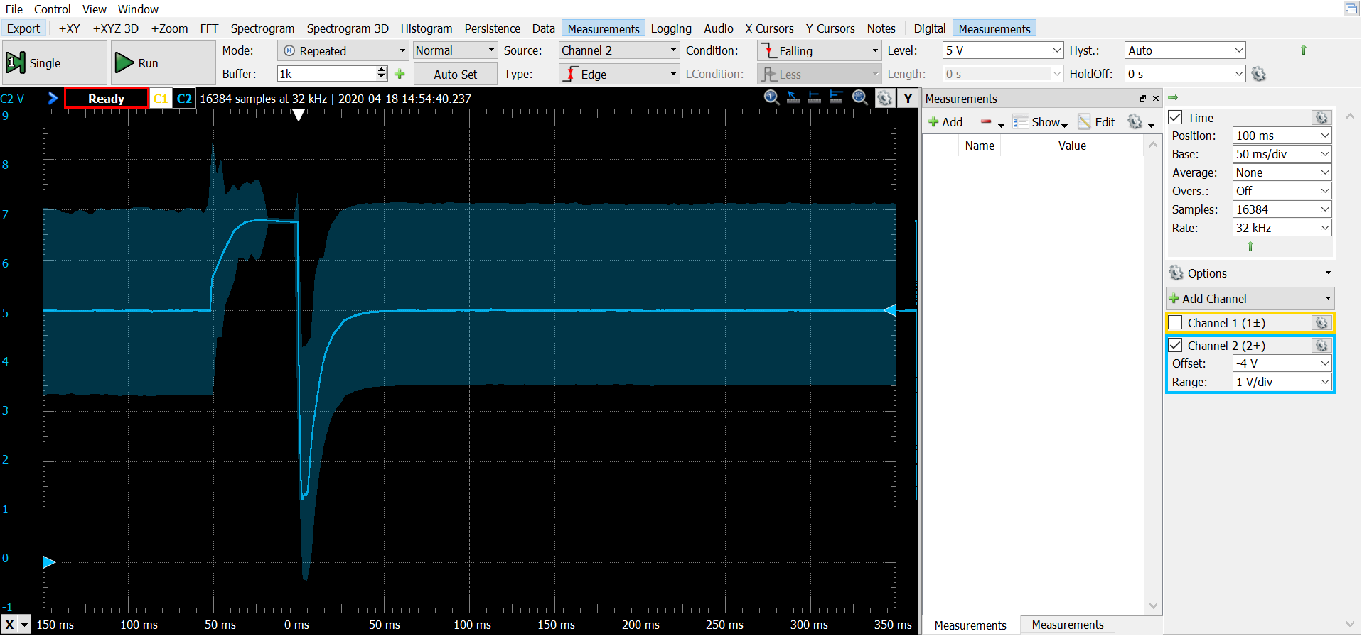
Recap : Mid-term presentation
Component selection
Gate driver
Circuit working on a breadboard
1st version of the PCB designed
System dynamics derived
PID controller
Integral controller: Step response
System dynamics
Circuit tested on a breadboard
PCB layout 1st version
Integral controller: Load switch 100 Ω ➔ 22 Ω

Slide 3
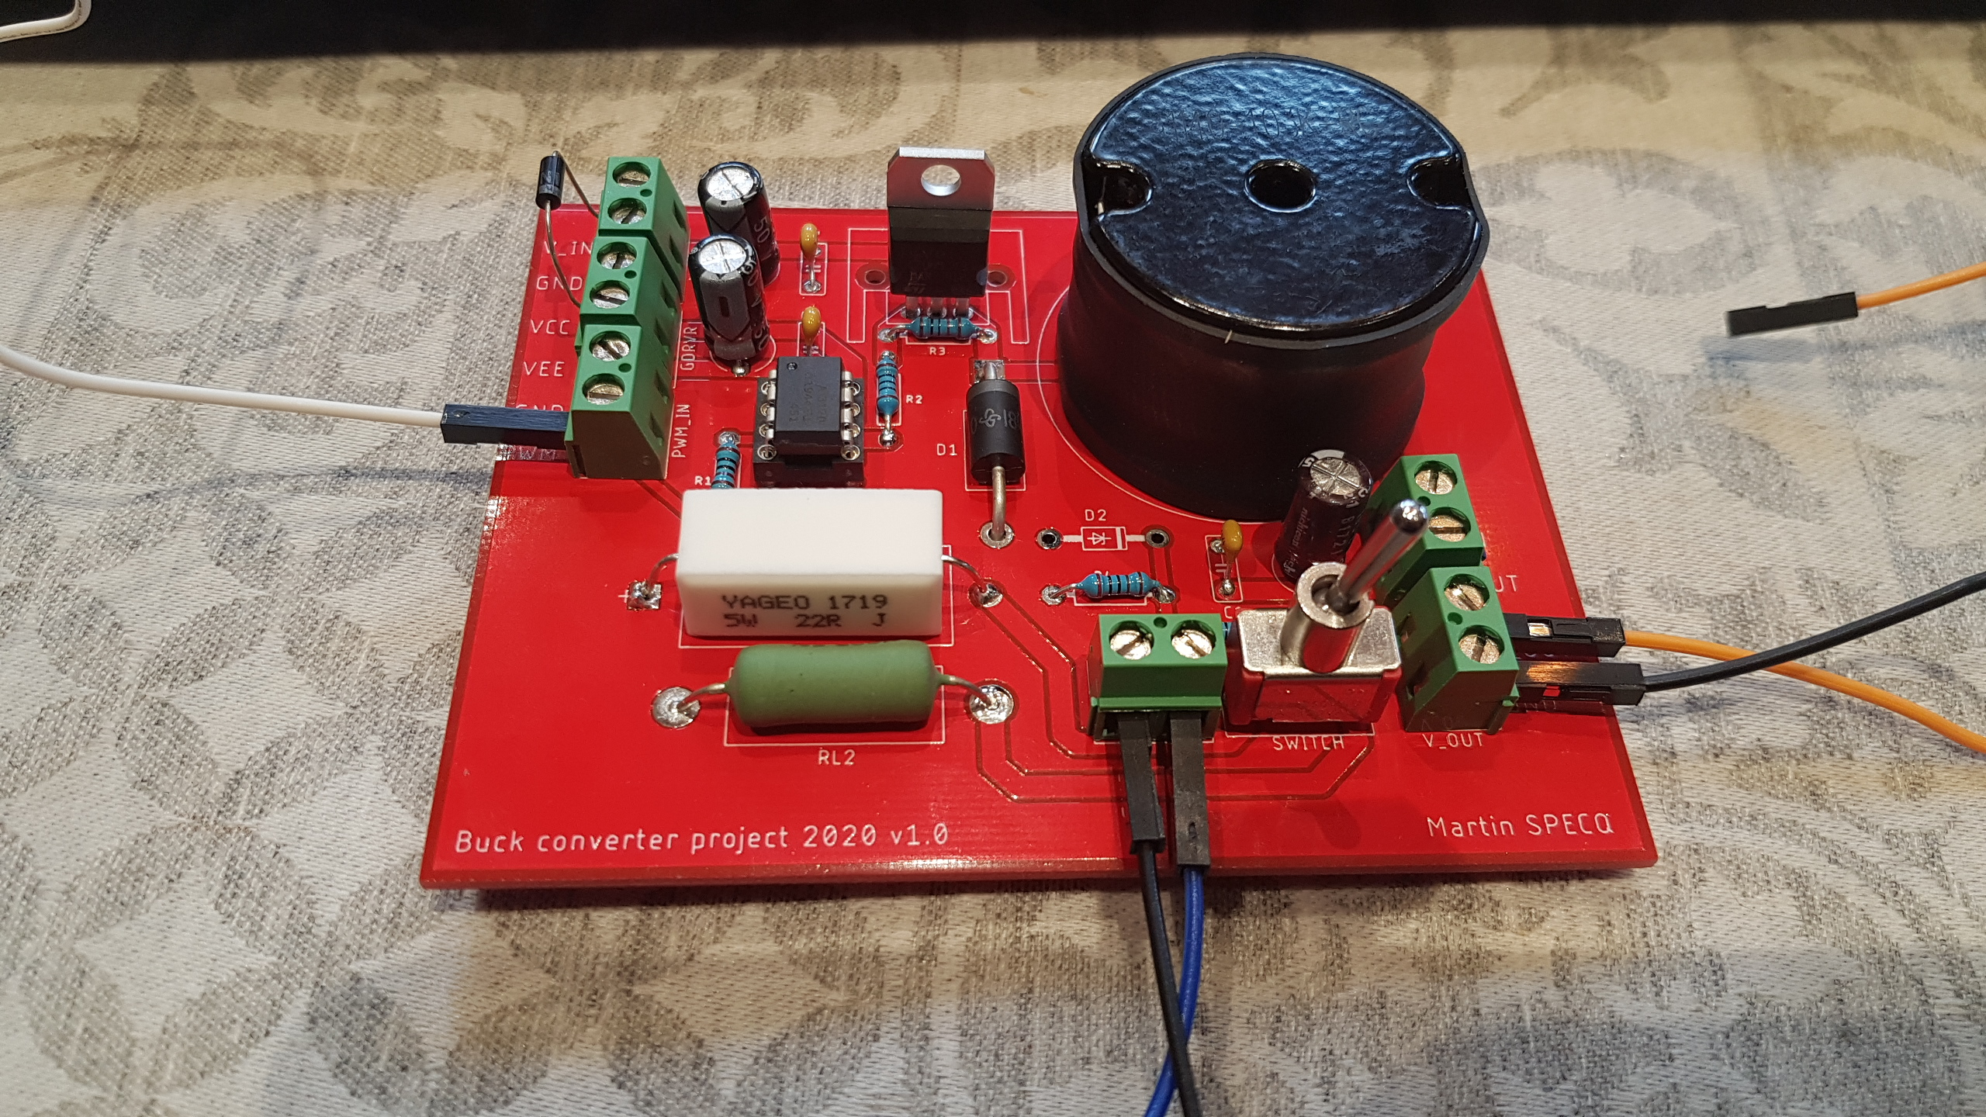
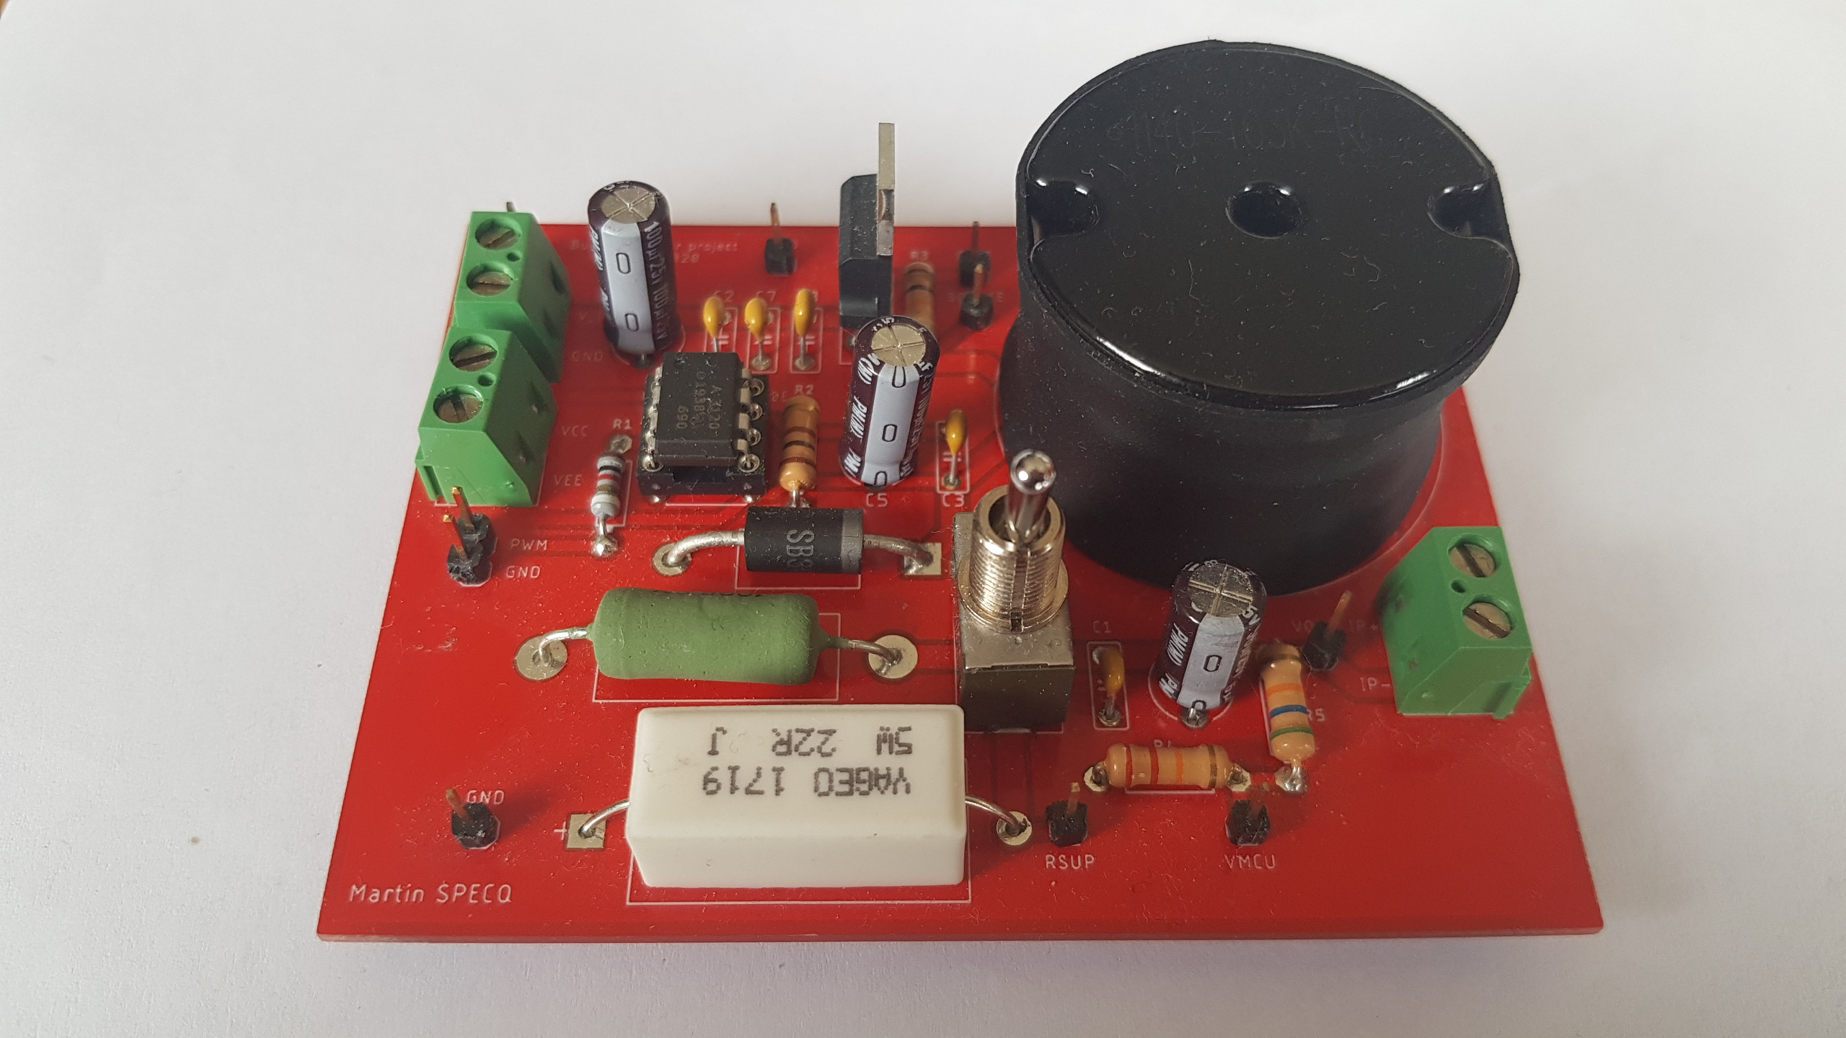
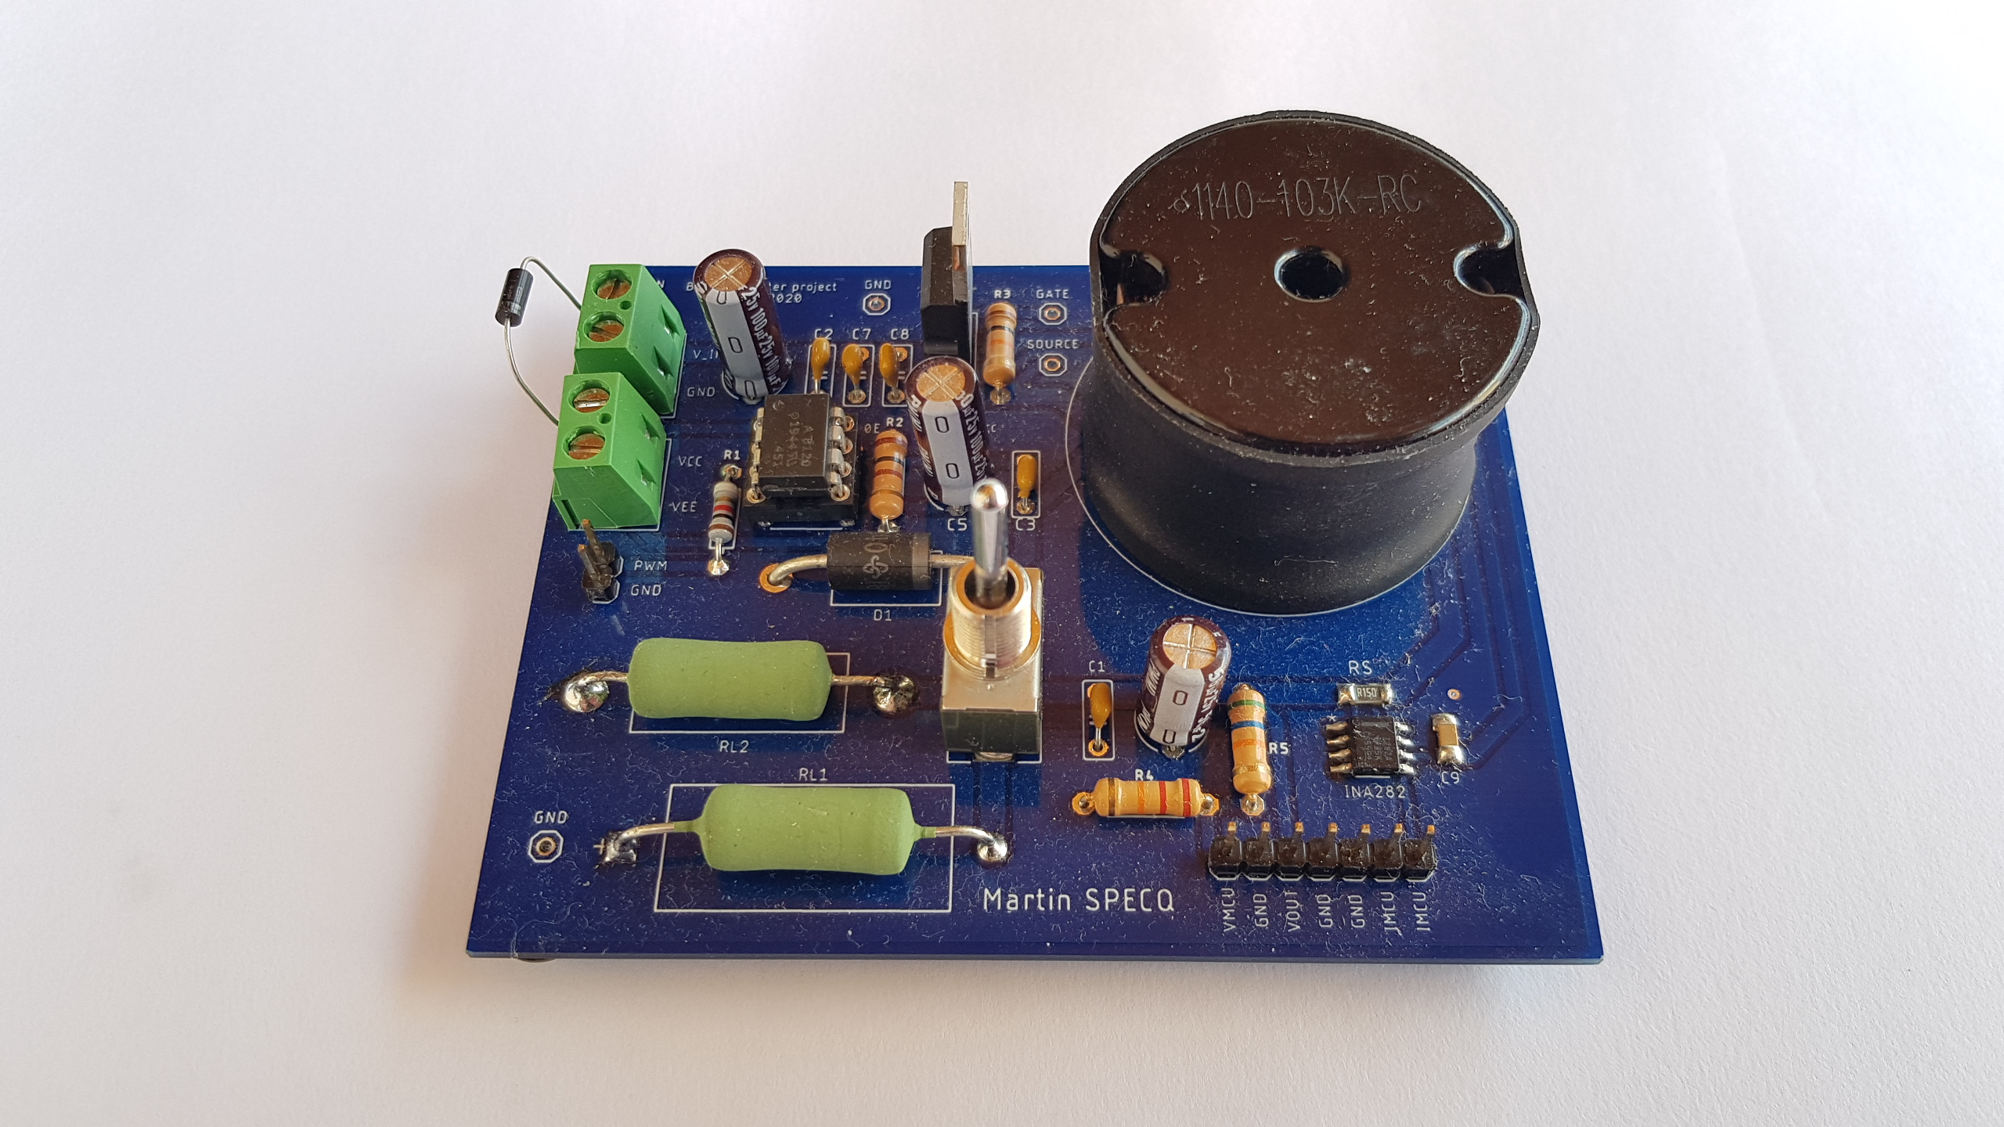
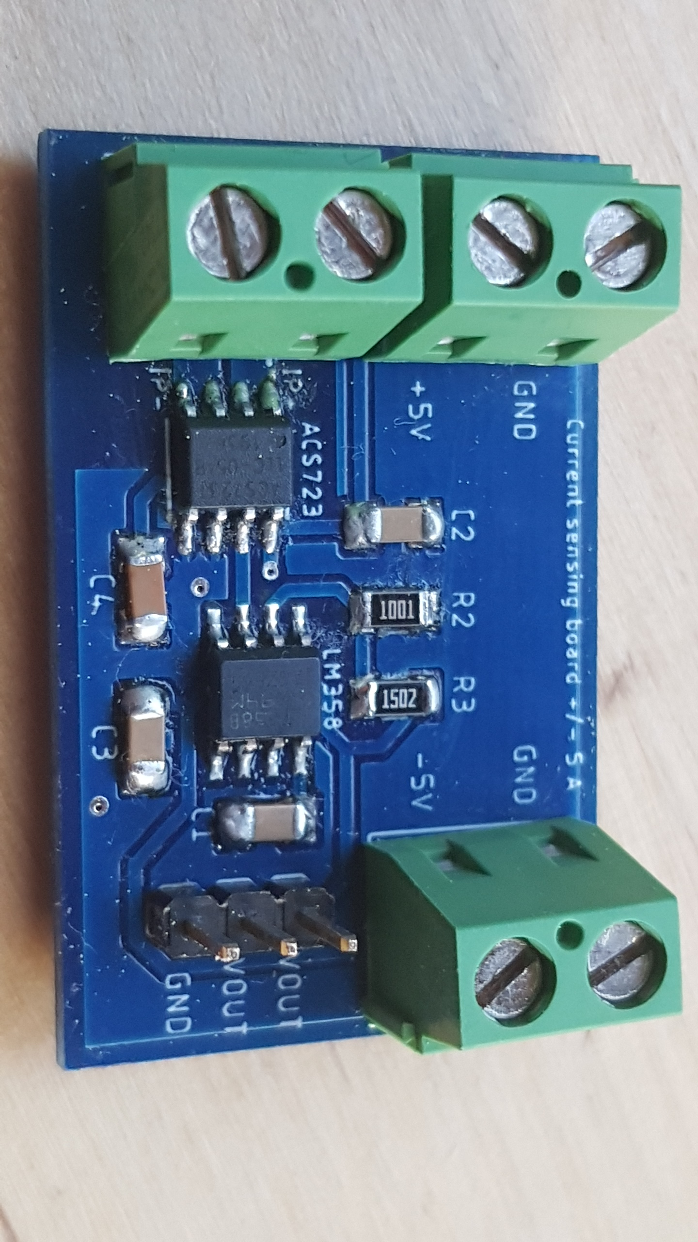
Circuit evolution
<
Version 1
Version 2
Version 3
One connection was forgotten
On-off-on switch => ghost load
Current sensor not embedded
Works fine for our goal
Current sensing board

Slide 4
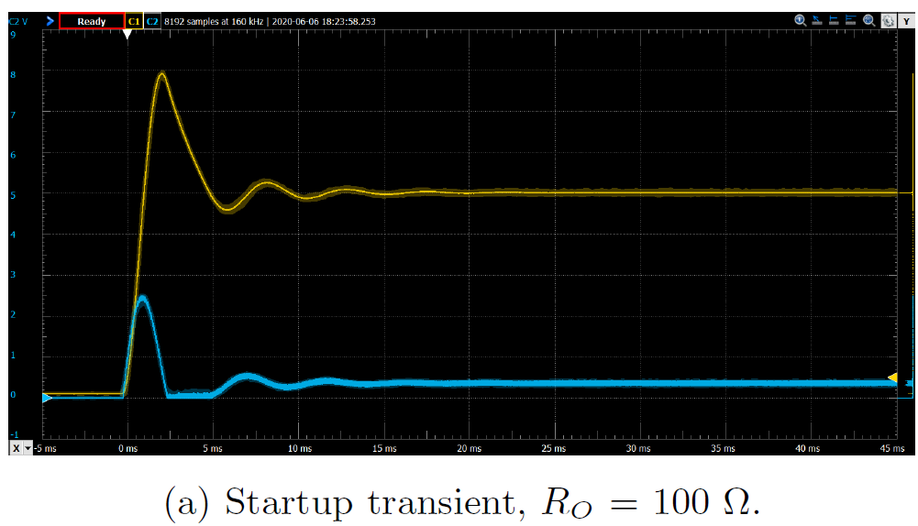
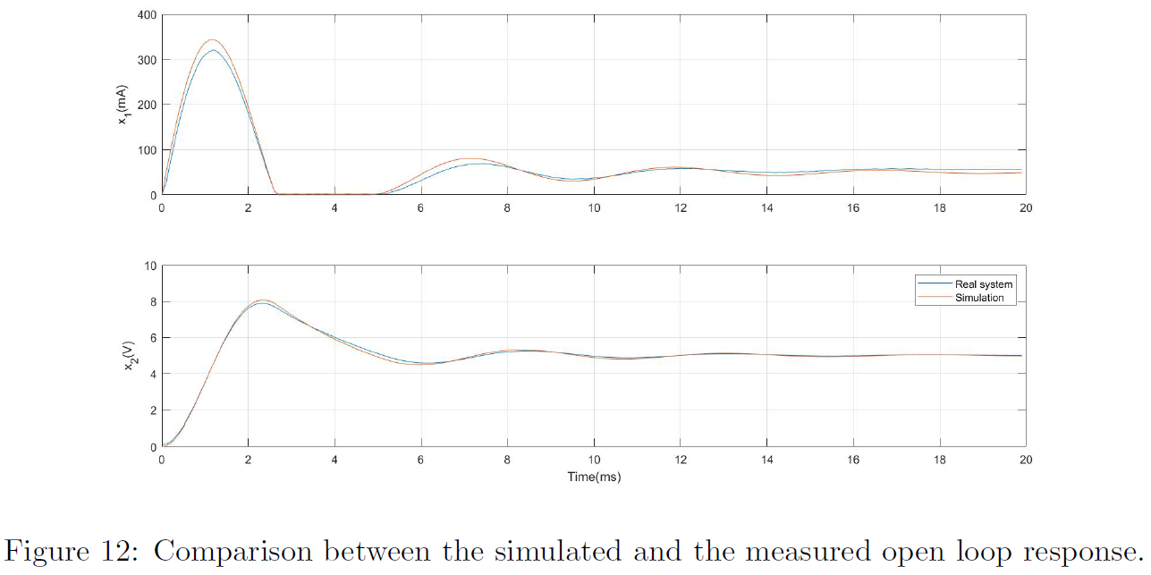
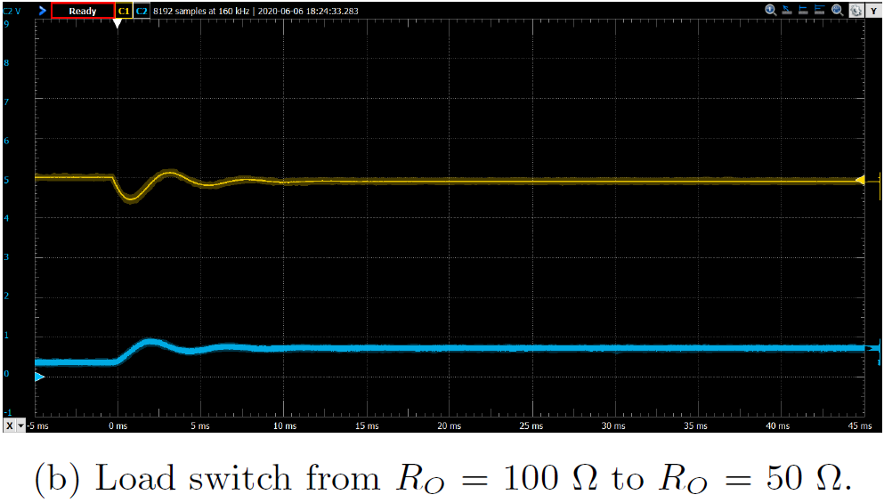
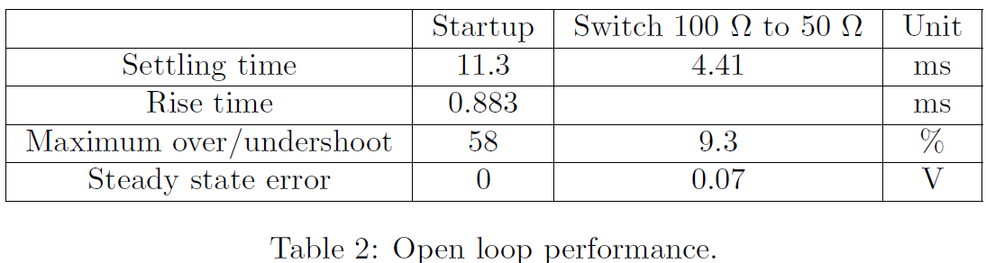
Open loop response
High overshoot
Oscillations
Steady state error
Long settling time
Objective: No steady state error, faster and smoother response
Very good match with the model

Slide 5
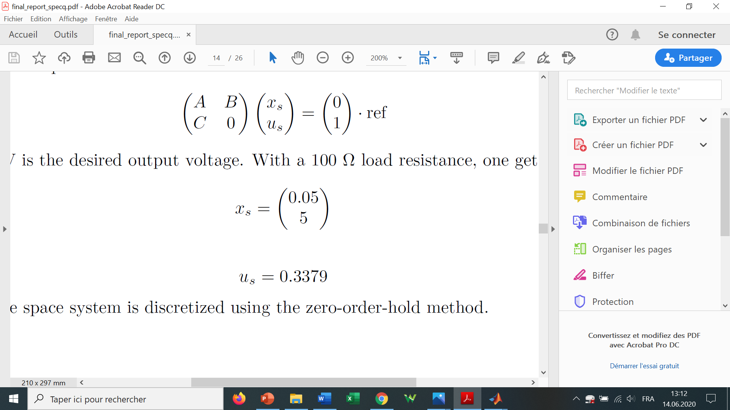
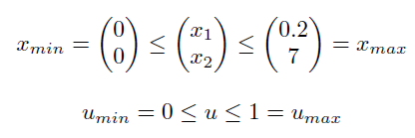
Model-based-control
Nominal load: 100 Ω
Goal: Regulation to 5 V, 50 mA
Steady state conditions:
Constraints:

Slide 6

Model-based control
Objectives:
  Comparison MPC vs LQR
  Testing the NN eMPC simplification
Investigations:
  Sampling frequency : 1 kHz, 10 kHz
  Switched controller, Nominal controller with integrator
  Luenberg observer, Kalman filter, No filter, Weighted sum, Median
  Orginal eMPC, Fitting eMPC, NN eMPC

Slide 7
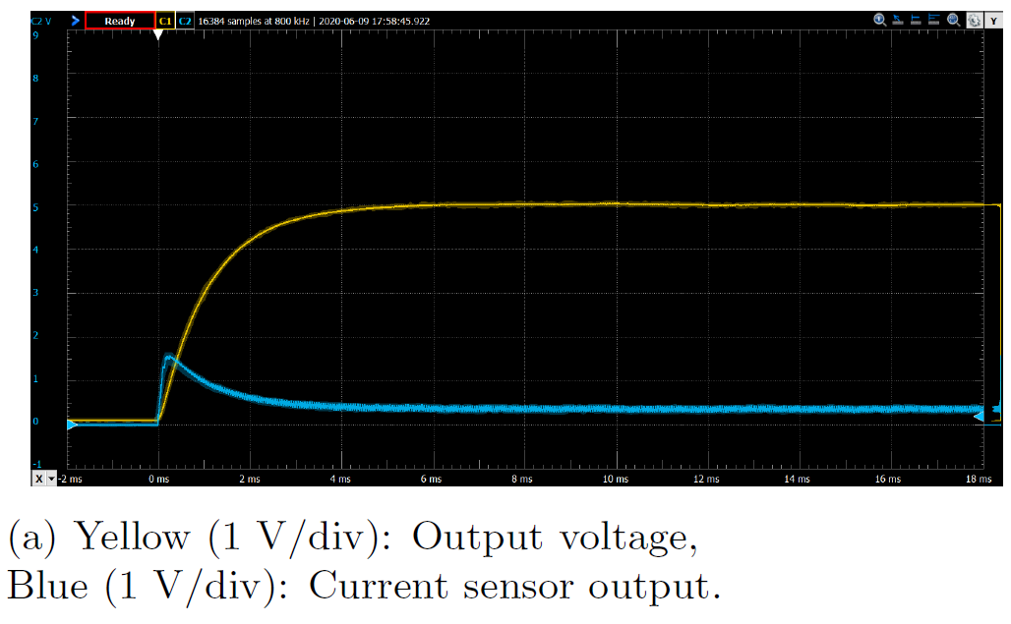
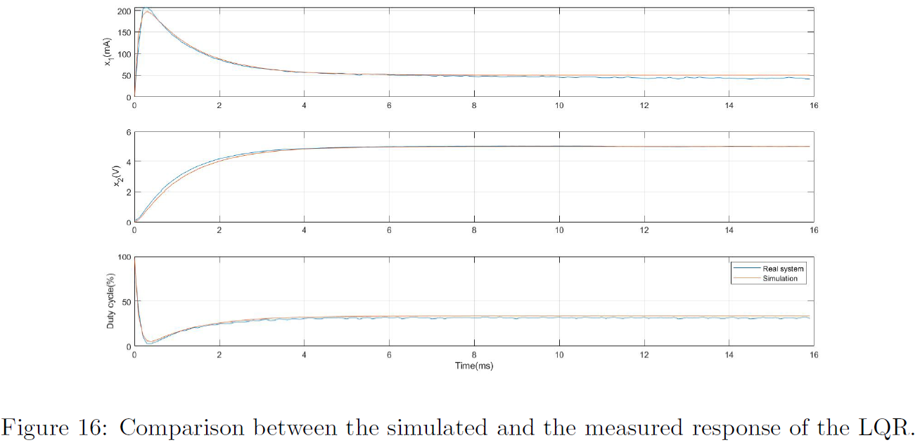
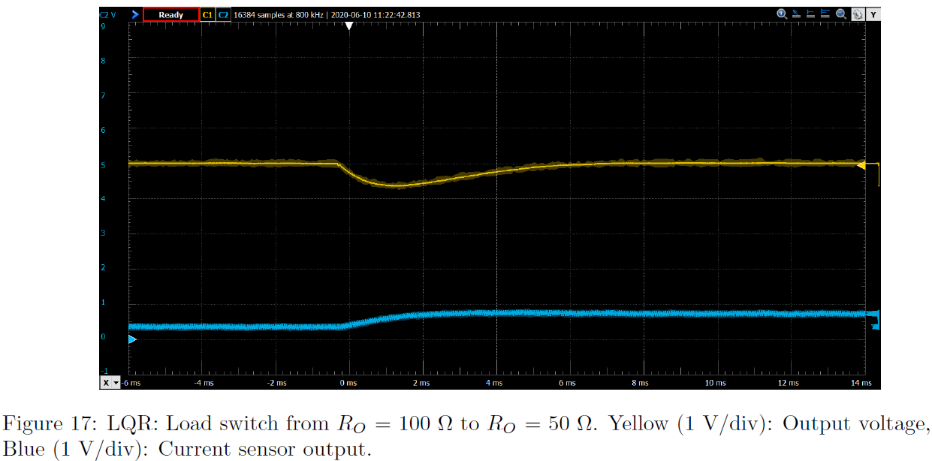
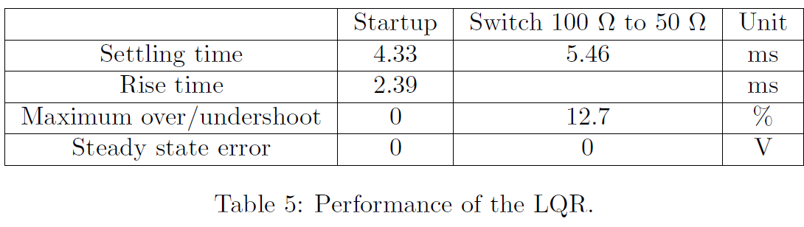
Model-based control : LQR
Q and R tuned according to the constraints
Integrator if the system is settled
Results:
  Fast
  No overshoot
  No steady state error
  Experiments stick to simulations
  => Good model

Slide 8
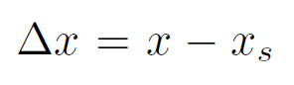
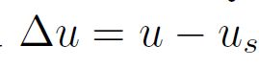
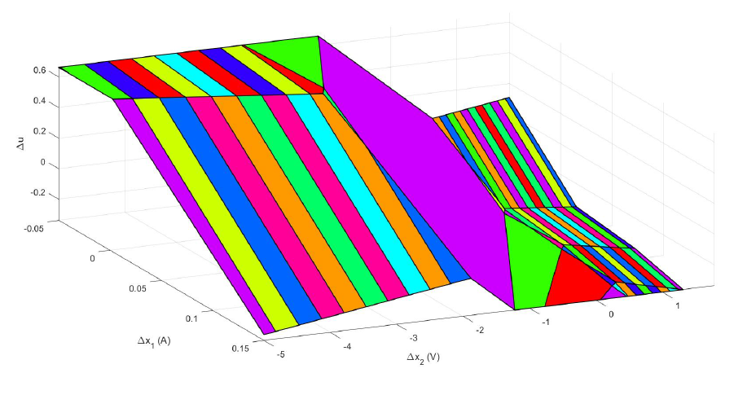


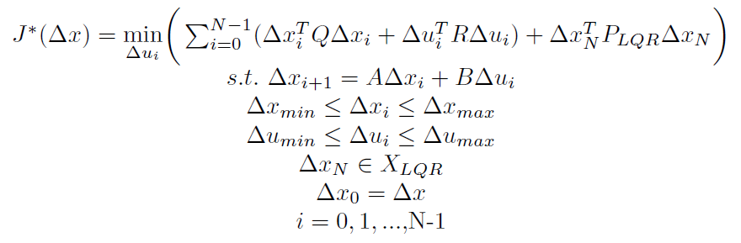
Model-based control : MPC
Change of variable:
Constraints:
MPC problem:
Optimal MPC optimizer vs state. Regions: 70.

Slide 9
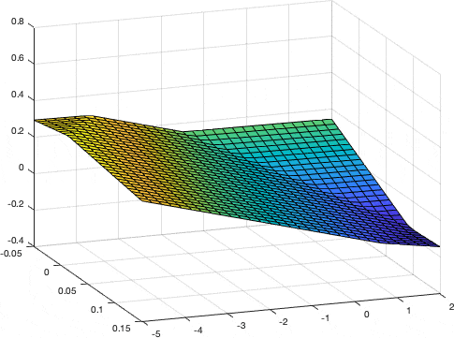
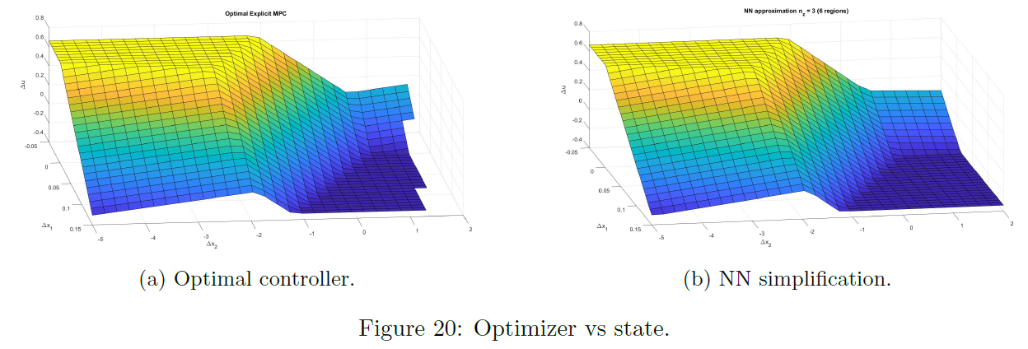
Model-based control : NN eMPC
NN learning the controller. Final regions: 6.

Slide 10
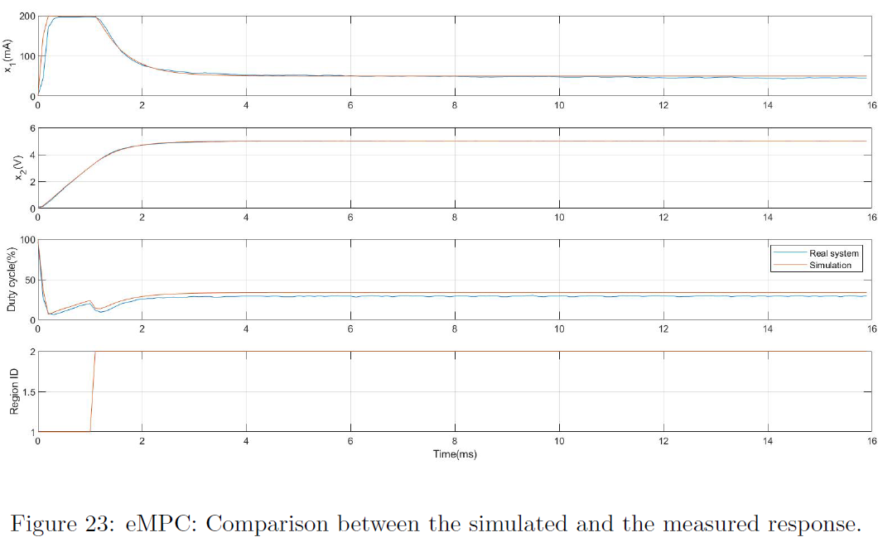
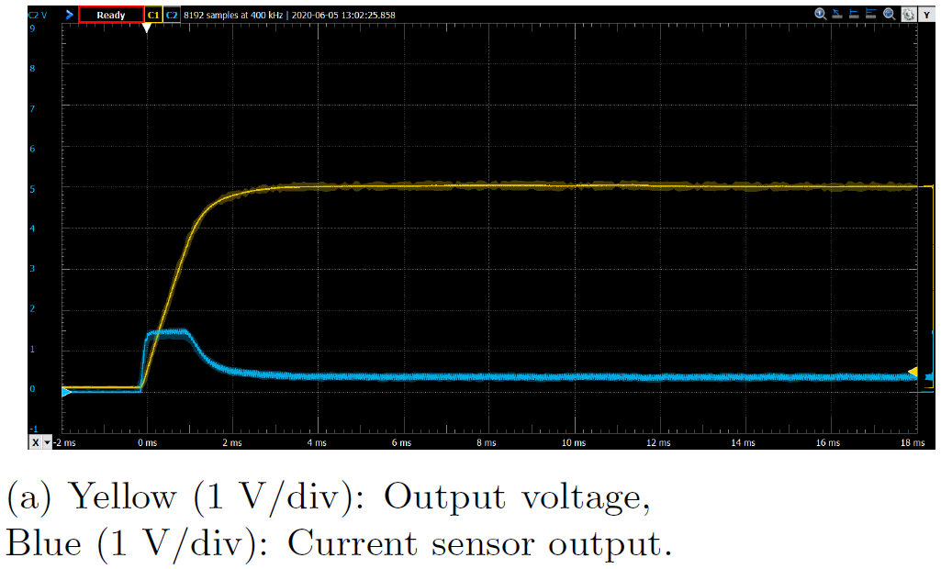
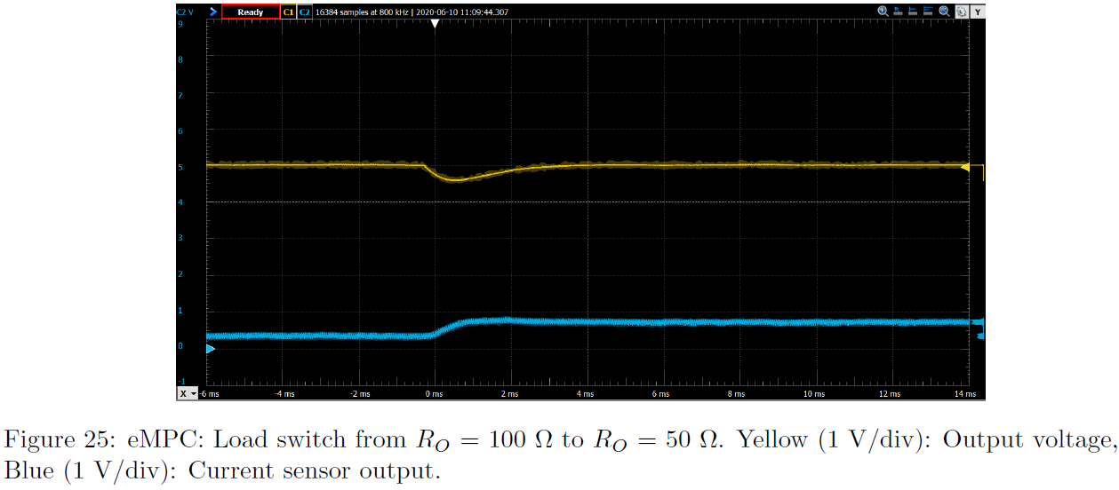
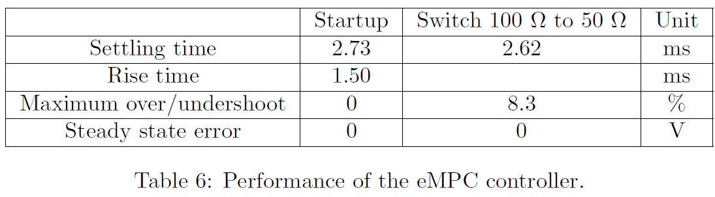
NN eMPC: Experimental results
Integrator if the system is settled and if the state is in the terminal set
Results:
  Faster than the LQR
  No overshoot
  No steady state error
  Current successfully clamped at the upper bound
  Once more, the real system is very close to the simulation

Slide 11
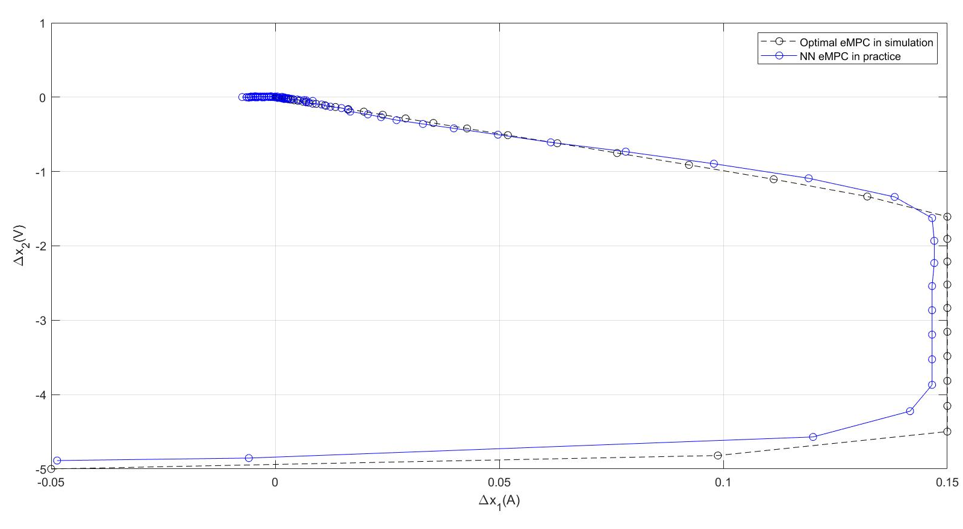
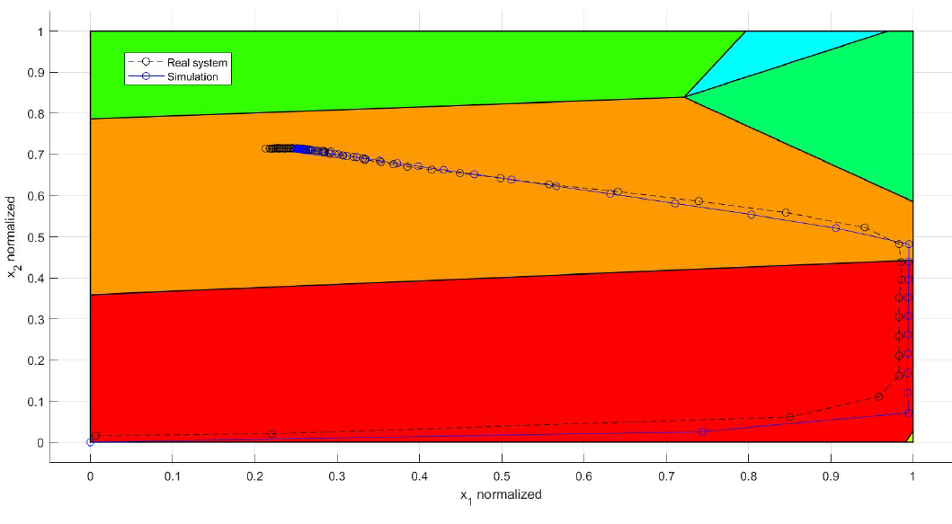
NN eMPC: Experimental results
State-space trajectories.

Slide 12
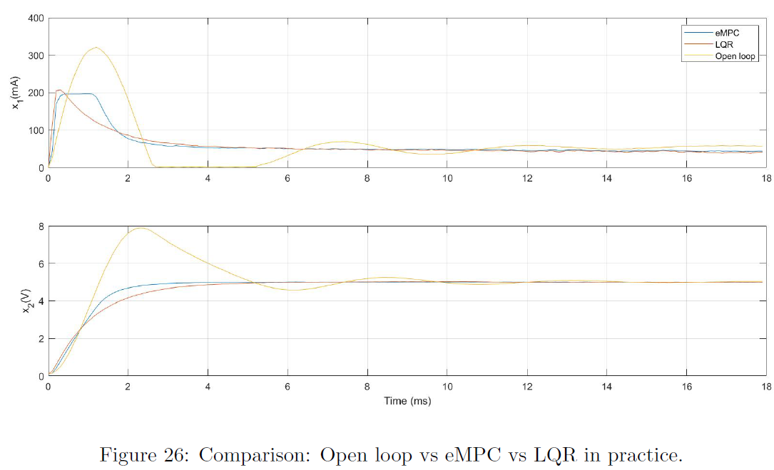
Open loop vs LQR vs NN eMPC
 | Open loop | LQR | NN eMPC
Settling time (ms) | 11.3 | 4.33 | 2.73
Overshoot (%) | 58 | 0 | 0
Performance Open loop vs LQR vs NN eMPC

Slide 13
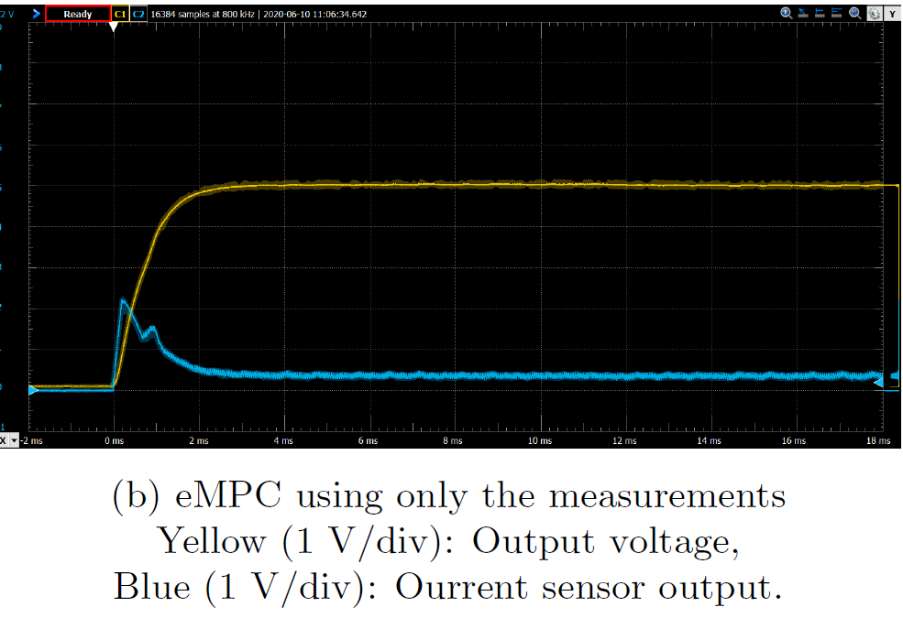
eMPC: Robustness limitations
Reaction delay => Plant-model mismatch => Constraints broken
Solutions:
  Adding a model component into the state estimate (what is done here)
  Robust MPC
  If possible, removing the delay by identifying its cause

Slide 14
Conclusion
Circuit tested on a breadboard
4 PCBs manufactured (3 main boards + 1 current sensing board)
Integral controller
Model-based control:
  LQR
  NN eMPC

